Slide 1
Rvalues and Move Semantics
Chapter 17

Slide 2
Objectives
Describe the difference between LValues and RValues.
Use RValue reference operator.
Compare overload methods based on reference types.
Describe move semantics and its usefulness.
Gain experience through code walk-throughs.
The example programs are in the chapter directory.

Slide 3
LValue versus RValue
Lvalue can appear on the left of an assignment.
Lvalue can evaluate to an addressable value
Rvalue can only appear on the right side of an assignment.
Rvalue cannot be evaluated to an explicit address
int FuncA(){
return 5;
}
int &FuncB() {
static int b=10;
return b;
}
void main() {
int a = 100; // a is lvalue
100 = a; // 100 is a rvalue
int c = FuncA(); // FuncA is rvalue
FuncB() = a; // FuncB is an lvalue.
}

Slide 4
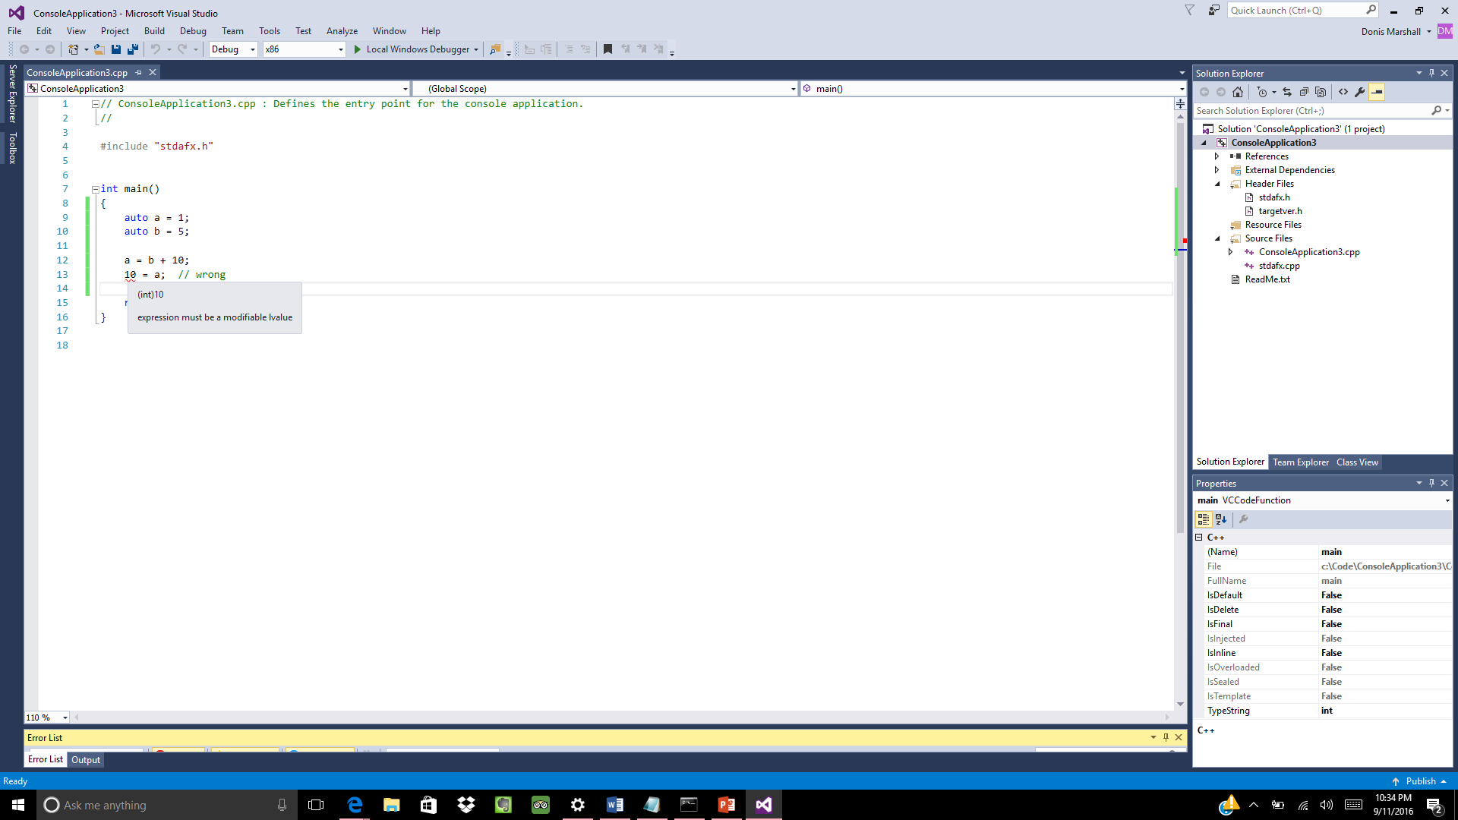
Literal Constants
Literal constants are an example of Rvalue.
They are not addressable.
Any attempt to use a Rvalue as an Lvalue will cause a compiler error.

Slide 5
Rvalue Reference Operator
& indicates an Lvalue reference.
Lvalue reference is a constant pointer to another object. Lvalue reference can only reference a Lvalue.
&& indicates an Rvalue reference for referencing Rvalues.
int a = 5;
int &b = a;
int &&d = 10;

Slide 6
Overload Reference Type
You can overload based on lvalue versus rvalue reference.
Compilers selects appropriate match.
// Which overloaded method is called in the following code?
void Func(int &var) {
cout << "Lvalue reference" << endl;
}
void Func(int &&var) {
cout << "Rvalue reference" << endl;
}
int main() {
int a = 5;
Func(a); // Lvalue ref
Func(10); // Rvalue ref
}

Slide 7
Universal Reference Type
Reference type within a template can be deduced at compile time.
Compilers selects appropriate match.
Provides support for perfect forwarding (discussed later)
template <typename T> void func(T &&t)
{
// "T &&" is a UNIVERSAL REFERENCE
cout << t << endl;
}
int main() {
int a = 5;
func(a); // Lvalue reference
func(5); // Rvalue reference
}

Slide 8
Copy vs Move Semantics
Copy and assignment can be expensive – especially temporary objects pointing to a lot of data. This can adversely impact performance and resource utilization.
Move semantics allows an object, under certain conditions, to take ownership of some other object's external resources.
If an object does not manage at least one external resource (either directly, or indirectly through its member objects), move semantics will not offer any advantages over copy.
template <typename T>
swap(T& a, T& b) {
T tmp(a); // copy constructor
a = b; // copy assignment
b = tmp; // copy assignment
}

Slide 9
copy semantics review
heap
A
B
A
B
B
deleted
deep copy
a
b
a
b
before
after a = b
Overloaded copy assignment operator

Slide 10
std::move
std::move() is a cast that produces an rvalue-reference to an object.
Using std::move allows you to swap the resources instead of copying them.
template <typename T>
swap(T& a, T& b) {
T tmp(std::move(a)); // move constructor
a = std::move(b); // move assignment
b = std::move(tmp); // move assignment
}

Slide 11
move assignment
a takes ownership
B
heap
A
B
Member data ‘zeroed’
b
a
b
NULL
a
after a = std::move(b)
before
Overloaded move assignment operator

Slide 12
Move assignment operator
Move assignment operators typically "steal" the resources held by the argument (e.g. pointers to dynamically-allocated objects)
The compiler will implicitly declare a move assignment operator if all the following are true:
there are no user-declared copy constructors
there are no user-declared move constructors
there are no user-declared copy assignment operators
there is no user-declared destructor
Data& operator=(Data&& rhs) { // argument is not const
if (this == &rhs) return *this; // don’t destroy yourself!
delete _data; // release what we hold
// scavenge rhs
_data = rhs._data;
rhs._data = nullptr;
return *this; // return this insatnce by ref
}

Slide 13
Move construction
a takes ownership
A
heap
A
Member data ‘zeroed’
b
a
NULL
a
After: T b( std::move(a))
move construct b from a

Slide 14
Move constructor
The purpose of a move constructor purpose is to transfer ownership of the managed resource from the source into the current object.
The move constructor is typically called when an object is initialized (by direct-initialization or copy-initialization) from an rvalue
The compiler will implicitly declare a move constructor if all of the following are true:
there are no user-declared copy constructors;
there are no user-declared copy assignment operators;
there are no user-declared move assignment operators;
there is no user-declared destructor.
/*
You can eliminate redundant code by writing the move constructor to call the move assignment operator as shown in the example.
*/
Data(Data&& rhs) { *this = std::move(rhs); }

Slide 15
The Rule of Five
The rule of three specifies that if a class implements any of the following functions, it should implement all of them:
copy constructor
copy assignment operator
destructor
The rule of five identifies that it usually appropriate to also provide the following functions to allow for optimized copies from temporary objects:
move constructor
move assignment operator

Slide 16
Perfect Forwarding
Like move semantics, perfect forwarding reduces overhead associated with a function call. Often, a function call is essentially a delegate to another function.
Calling FuncB is essentially a call to FuncA. However, there is additional overhead of two pass by value calls instead of one pass by value call. If obj is a heavy object, the additional overhead could be considerable.
Here three copy by value constructors are called.
class ClassA {
public:
Foo() { cout << "Regular ctor" << endl; }
Foo(const ClassA & obj) { cout << "Regular ctor" << endl; }
};
void FuncA(ClassA obj) { }
void FuncB(ClassA obj) { FuncA(obj);
int main() {
ClassA obj;
FuncB(obj);
return 0;
}

Slide 17
std::forward()
Perfect forwarding removes the potential additional overhead of functions that are thin wrappers for delegating to another function.
Perfect forwarding is accomplished with a combination of move semantics and std::forward to forward parameters through a thin wrapper.
template<typename T>
void Func(T b) { std::cout << "Func " << b.data() << std::endl;
}
template<typename T>
void Wrapper(T&& b) {
Func<T>(std::forward<T>(b)); // Forward as lvalue or as rvalue, depending on T
}

Slide 18
Summary
In C++11, in addition to copy constructors, objects can have move constructors.
And in addition to copy assignment operators, they have move assignment operators.
The move constructor is used instead of the copy constructor, if the object has type "rvalue-reference" (Type &&).
std::move() is a cast that produces an rvalue-reference to an object, to enable moving from it.

